Slide 1
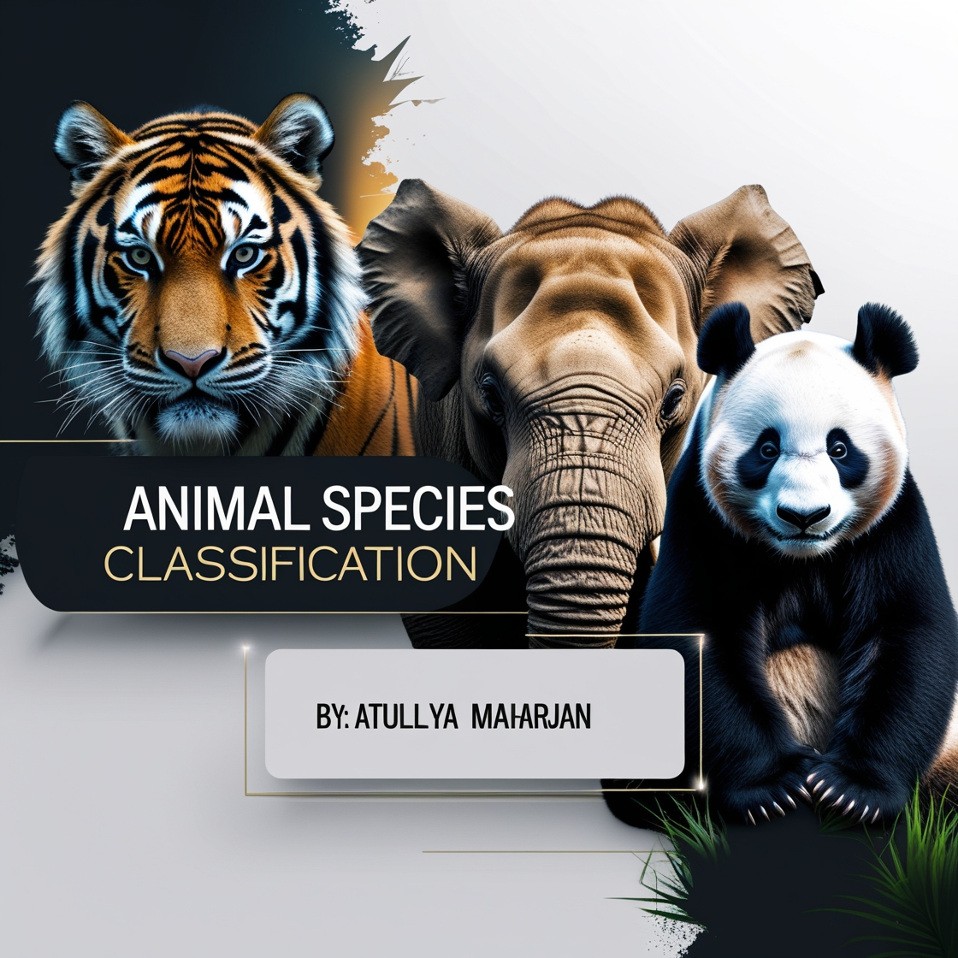

Slide 2


Agenda
A
Introduction
Problem Statement
Dataset
Machine Learning Approach
Model Training & Evaluation
Challenges & Limitations
Conclusion

Slide 3
Introduction
The process of identifying and categorizing animals based on their features is called Animal Species Classification.
It is important for wildlife monitoring, conservation, and research.

Slide 4
Why Use Machine Learning?
Traditional methods rely on manual identification, which is time-consuming and can lead to mistake.
ML models automate classification, making the process faster, more accurate, and scalable.

Slide 5
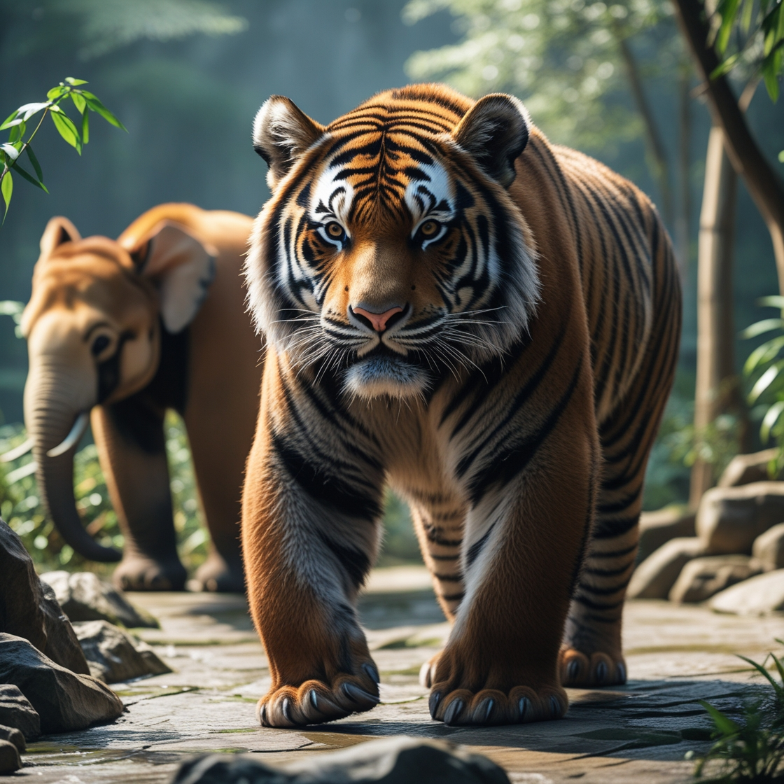
Challenges in Animal Species Classification
Problem Statement
Requires domain expertise (Zoologists, researchers).
Time-consuming and prone to human errors.
Animals may look similar (e.g., a striped animal could be a zebra or a tiger).

Slide 6
Dataset
Source of Data: Kaggle
Number of classes :4 (Tiger, Zebra, Panda, Elephant)
Images per class:100
Data Preprocessing
Data Augmentation (for Training Images)

Slide 7
Machine Learning Approach

Slide 8
Model Architecture: Convolutional Neural Network (CNN)
Why CNN?
CNNs are excellent at processing image data by learning patterns, textures, and shapes.
They automatically extract important features like stripes for tigers or black-and-white patches for pandas.

Slide 9
Model Training & Evaluation

Slide 10
Training Process
Dataset Split:
Data Augmentation (Preprocessing for Training Data):
Training Set: Used to train the model.
Validation Set: Used to tune hyperparameters and avoid overfitting.
Testing Set: Used to evaluate the final performance.
Improves model generalization by applying:
Rotation (30°)
Shifting (Width & Height
Shearing & Zooming
Horizontal Flip

Slide 11
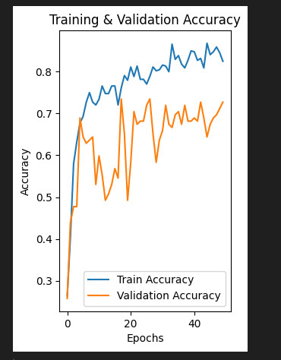
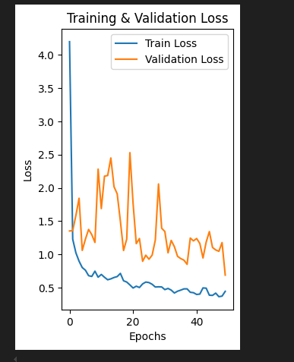
Model Performance Visualization
Training vs. Validation Accuracy & Loss

Slide 12
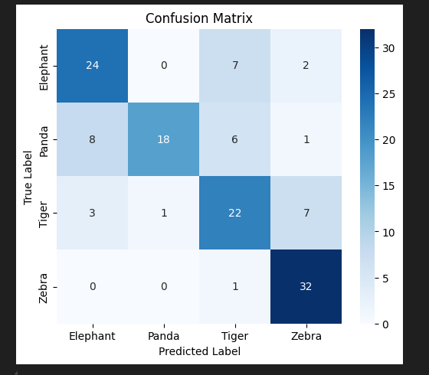
Confusion Matrix (Performance Breakdown per Class)

Slide 13
Challenges & Limitations
“
”

Slide 14

Limited Dataset (Only 4 Classes, 100 Images Each)
Misclassification of Unknown Classes
The model sometimes predicts "Unknown" correctly for images outside the trained classes.
However, it sometimes misclassifies unknown objects (e.g., a human face or a different animal like a lion) as one of the four trained classes (elephant, panda, zebra, or tiger).
Feature Similarity Problem
The model relies on features like fur texture, shape, and colors.

Slide 15
Conclusion
Developed a deep learning model to classify four animal species(Elephant, Panda Tiger, Zebra).
Achieved good accuracy on known classes but faced challenges with unknown species

Slide 16
References
https://www.kaggle.com/datasets/utkarshsaxenadn/animal-image-classification-dataset
https://dl.acm.org/doi/fullHtml/10.1145/3573428.3573691#:~:text=Deep%20learning%20models%20can%20achieve,especially%20in%20images%20classification%20area.
https://www.geeksforgeeks.org/introduction-convolution-neural-network/

Slide 17


Slide 18
Thank you
🐶

